Slide 1





Fisher Bygland Lutheran Parish July 2026
Sunday | Monday | Tuesday | Wednesday 1 6 PM BIO Girls | Thursday 2 | Friday 3 | Saturday 4
5 9:00 AM Worship at Fisher 10:00 AM Coffee Fellowship *Noisy Offering* | 6 9:00 AM Quilting at Fisher | 7 9:00 AM Quilting at Fisher | 8 6 PM BIO Girls 7:30 Bygland Council | 9 | 10 | 11
12 9:00 AM Worship at Bygland 10:00 AM Coffee Fellowship | 13 | 14 | 15 9:00 WELCA Bible Study 6 PM BIO Girls 7:30 Fisher Council | 16 | 17 | 18
19 9:00 AM Worship at Fisher 10:00 AM Coffee Felowship | 20 | 21 | 22 6 PM BIO Girls | 23 | 24 | 25
26 9:00 AM Worship at Bygland 10:00 AM Coffee Fellowship | 27 | 28 | 29 6 PM BIO Girls | 30 | 31
Pastor Nicholas Rohde
Cell: 507-696-1492
Secretary: Hayley Childress
Office Phone: 218-891-4632
Bygland
Ushers: Jeff Millar
Altar: Rachel Traub & Mary Don Krostue
Work Group 4: Al & Linda Halvorson
Jeff Millar
Holy Communion
Fisher
Head Usher: Bruce Newhouse
Altar: Reed & Sheryl Tinkham
Work Group 1: Bruce & Tami Newhouse

Slide 2



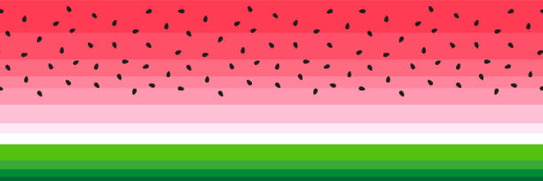
Fisher Bygland Lutheran Parish August 2026
Sunday | Monday | Tuesday | Wednesday | Thursday | Friday | Saturday 1
2 9:00 AM Worship at Fisher 10:00 AM Coffee Fellowship *Noisy Offering* | 3 | 4 | 5 6 PM BIO Girls | 6 | 7 | 8
9 9:00 AM Worship at Bygland 10:00 AM Coffee Fellowship | 10 9:00 AM Quilting at Fisher | 11 9:00 AM Quilting at Fisher | 12 BIO Girls 5K | 13 | 14 | 15
16 9:00 AM Worship at Fisher 10:00 AM Coffee Fellowship | 17 | 18 | 19 9:00 WELCA Bible Study 7:30 Fisher Council | 20 | 21 | 22
23 9:00 AM Worship at Bygland 10:00 AM Coffee Fellowship 30 9:00 AM Worship at Fisher 10:00 AM Coffee Fellowship | 24 9:00 AM Quilting at Fisher 31 | 25 9:00 AM Quilting at Fisher | 26 6 PM BIO Girls | 27 | 28 | 29
Pastor Nicholas Rohde
Cell:507-696-1492
Secretary: Hayley Childress
Office Phone: 218-891-4632
Bygland
Ushers: Steve Short
Altar: Danielle Brundin & Becky Moe
Work Group 1: Al & Linda Halvorson
Jeff Millar
Holy Communion
Fisher
Head Usher: Reed Tinkham
Altar: Aaron & Lana Motl
Work Group 1: Bruce & Tami Newhouse

